Slide 1


MAI Projects 2022-23
Time to choose a project….
Prof. Naomi Harte
MAI Projects, Academic Lead
April 2022
Note – there is audio. Just run the slide show and click through the slides….

Slide 2
Who needs an MAI project?
If you are entering your 5th year of the MAI programme in Sept 2022
Having met all requirements
All streams/pathways
A, B, C, CD, D, Bio, EM
Some visiting students (InternationalEng@tcd.ie in School Office is your contact)

Slide 3
How the MAI projects work
School level allocation
2 year programme to align projects across the school
All students use a single project allocation process
You explore the projects that are available and suitable
Rank your top 10 projects
Then based on ranking from JS year, starting with the student at the top of that list, you get the top available choice when we get to you on that list (CAO style)

Slide 4
Making a choice (1)
MAI projects must have a research element
30ECTS – through the two Semesters
Half your time in 5th year
Something you are motivated by, willing to work hard on
25 hours a week is the indicative student effort

Slide 5
Making a choice (2)
Start with the high level list of project
Excel Sheet
MAI_project_summary_2223.xls
Lists all project titles, stream suitability, keywords
Can filter by stream, search for keywords

Slide 6
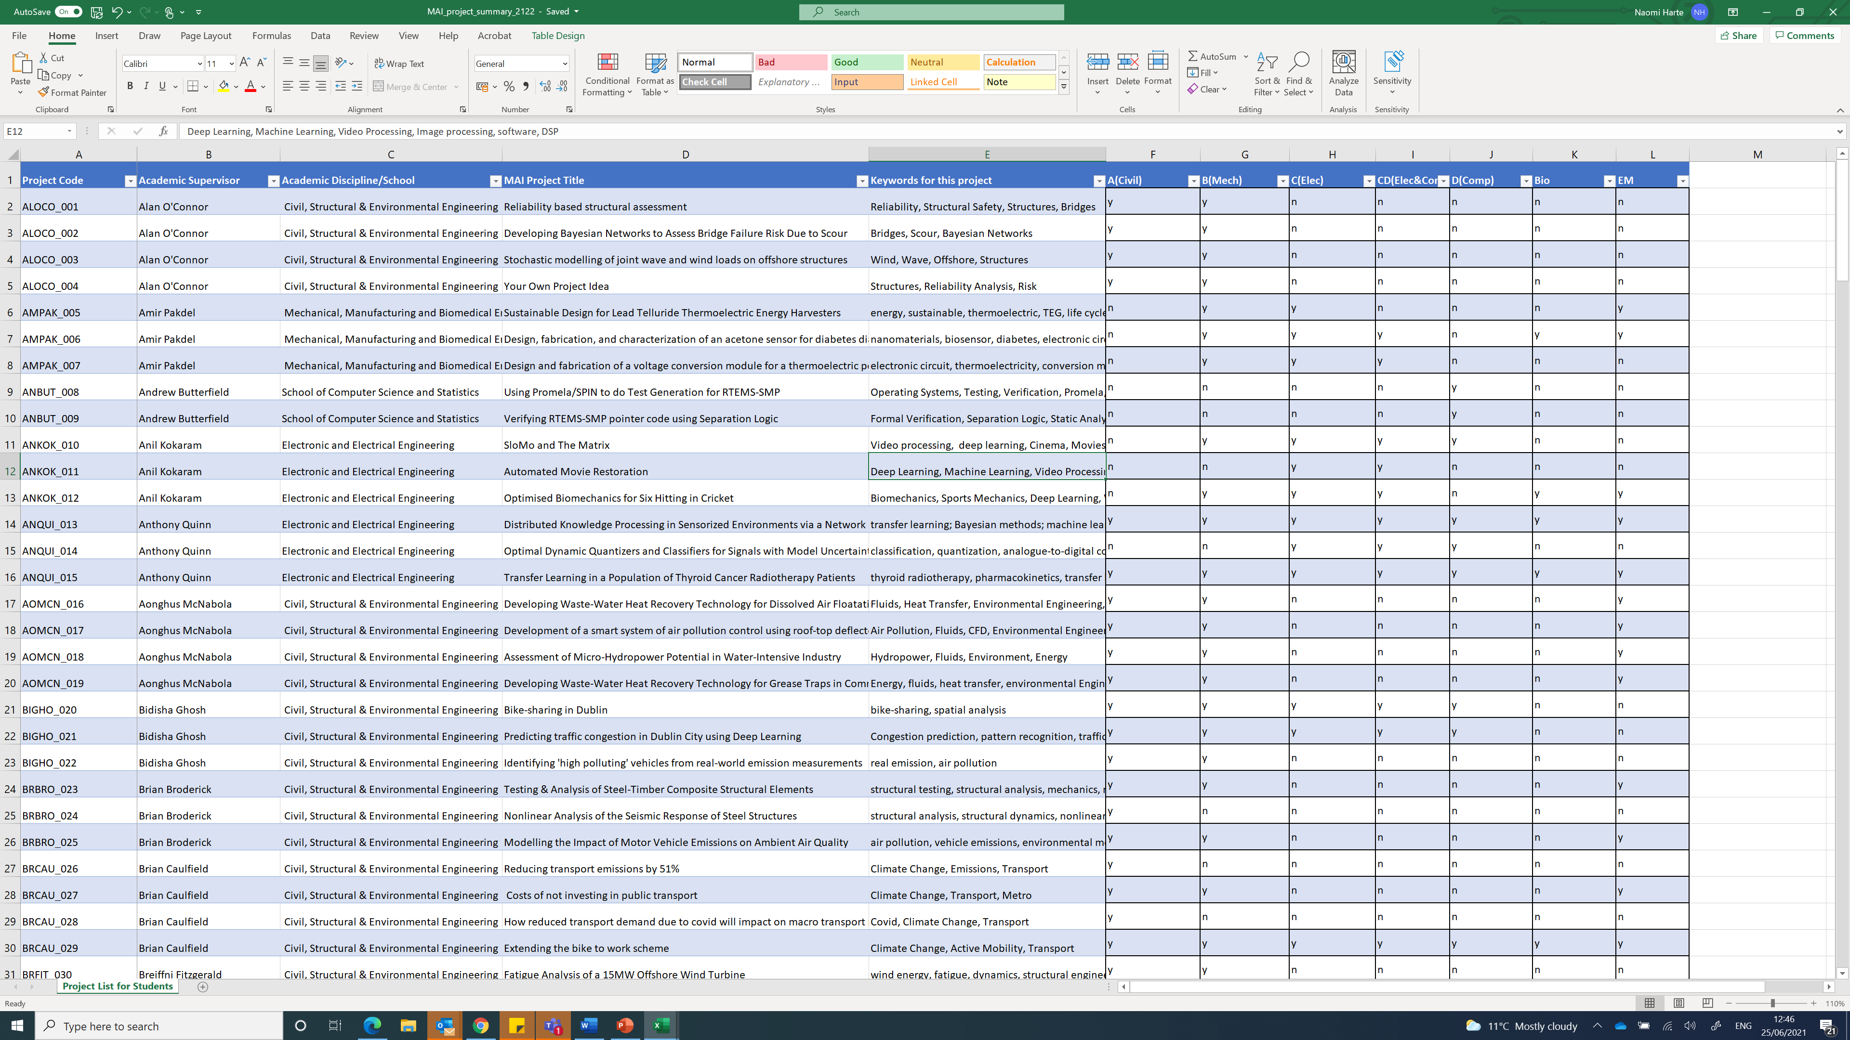
The summary spreadsheet
Project suitable for these streams (yes/no)
Keywords
Project Codes

Slide 7
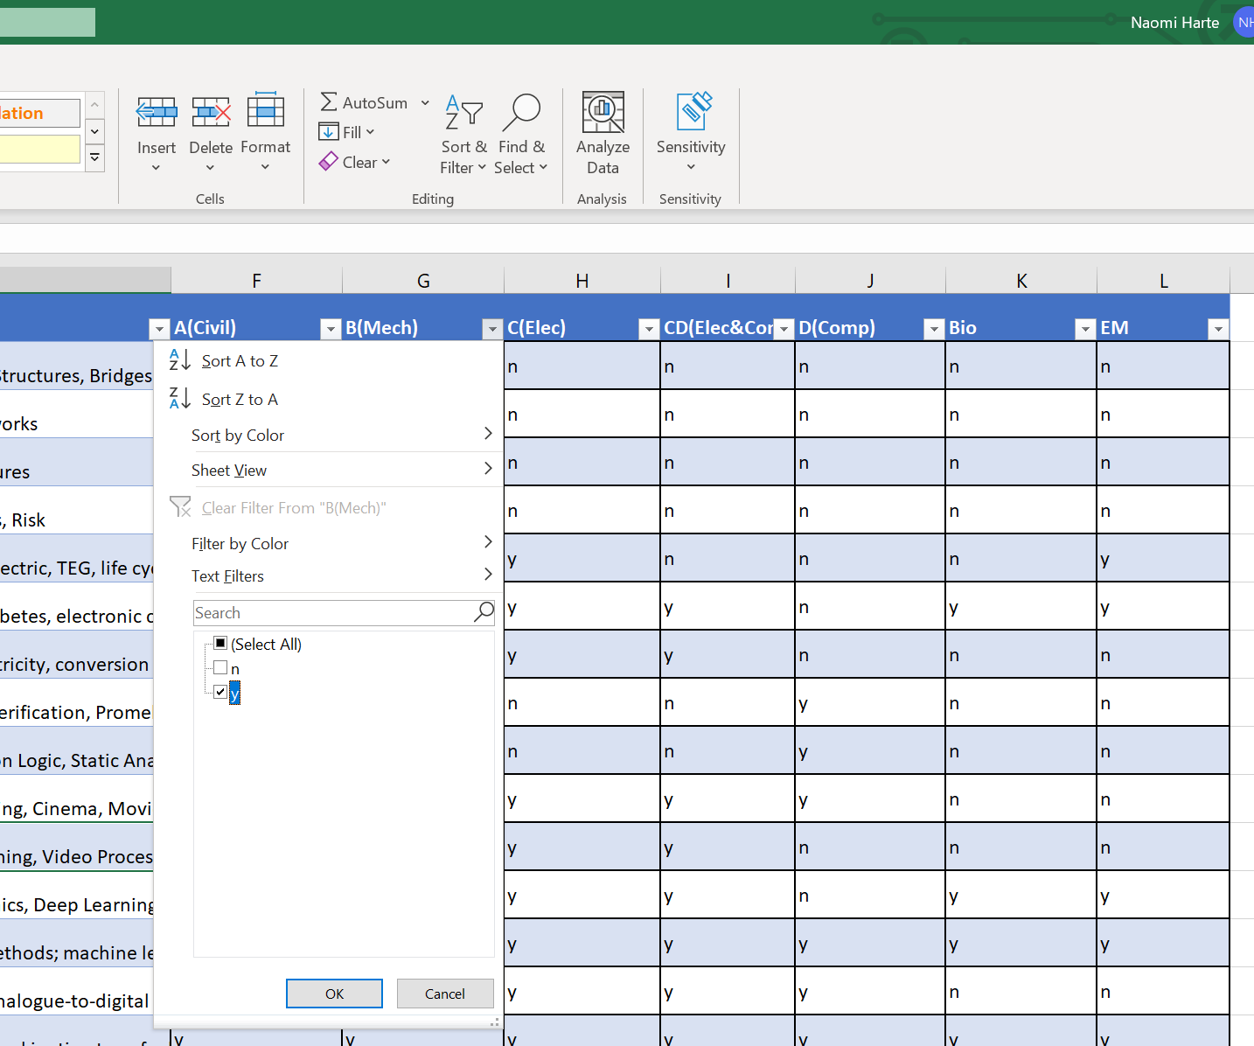
Filtering the summary sheet
1. Click to filter
This will reduce the list to only show titles suitable for a particular stream (B in this example)
Note many projects are suitable for multiple streams
The academic supervisor will focus the project according to your background
Your supervisor does not have to be from your own “home” stream
2. Show projects with a “yes” for B(Mech) stream
3. Click OK

Slide 8
More detailed information
To help you make an informed choice
Use the PDF of projects to get more detailed information
MAI_projects_2223.pdf
This document gives details of over 200 projects!!
You need to find 10 you are interested in, and rank them

Slide 9
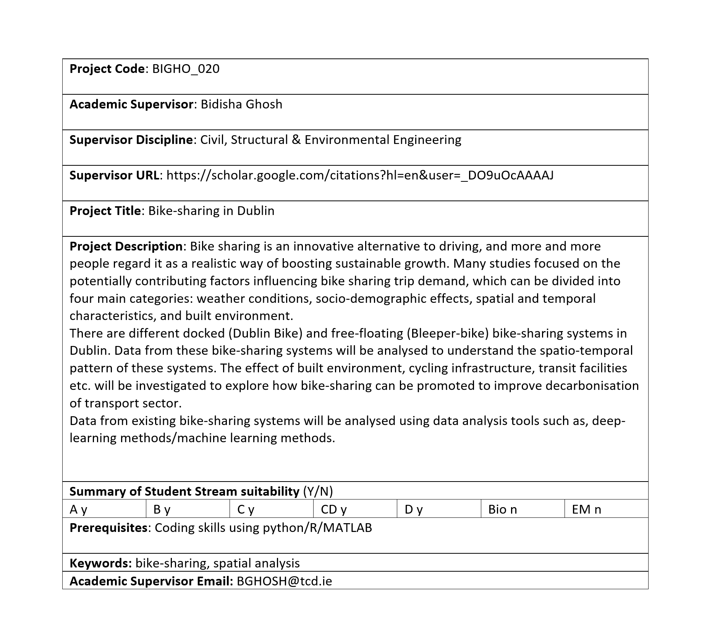
Sample Description
Unique code
Find out more about this supervisor’s research
More details
You must be able to fulfil these to take this project
Is it suitable for someone in my stream?
You can optionally email the supervisor if you have concerns/questions

Slide 10
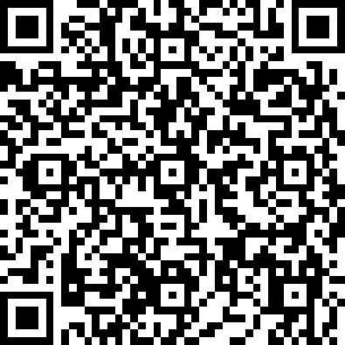
Make your choices
Register your 10 ranked options
Complete the projects form to register your choice of TEN projects
You need the code of each project
It is important to rank them properly as you may not get your first choice, or even 3rd choice of project, and supervisor loads will be balanced
Fill out the form at:
https://forms.office.com/r/pDa2iA6DYj
Deadline 4pm Monday May 30th

Slide 11
Project allocation
Choices will be published via email to the incoming MAI class by mid July
You will have to accept the project via another form. Not filling out this form means your project goes back in the unallocated pool.
In August, we will take care of students who, for whatever reason, do not have a project, using whatever projects remain unallocated.
By September, you are enrolled in a local module for the MAI project
Module is determined by the Discipline of your Supervisor
e.g. a Bio student taking a project with Prof. Anil Kokaram will be enrolled in EE5E1
In September make sure you are correctly enrolled!!

Slide 12
Moving around the School
Unified approach to projects
Module you enrol in depends on where your supervisor is
Local MAI Co-ordinator
An administrative necessity
All now called “Engineering Research Project”
Same sequence of assessments, with slight local date differences
e.g. Project Plan presentations

Slide 13
Assessment common across Engineering
*Won’t be the same if you have a CS supervisor
Assessment Component | Assessment Description | LO Addressed | % of total | Week due
Project Plan | 5-minute Presentations including background to project, clear goal and proposed path forward. Followed with 5 minutes questions/feedback from academic/technical staff. | 1-6 10,11,12 | 5 | Week 6 of Teaching in Sem1 (arranged by local co-ordinators)
Interim Report | Progress report in Sem1 | 1-9,12 | 10 | Week 10 Sem1
Thesis | Masters-level thesis | All | 85 | Last day of Teaching in Week 12, Semester 2
Viva-Voce Presentation and Examination | Supervisor and second reader to attend; separate chair if required by supervisor. Supervisor and 2nd reader initial mark sheet uploaded by end of week 13 with final mark agreed at Viva. |  |  | Within Revision Week or Exam Period of Semester 2 (organised with Supervisor)

Slide 14
Getting started…
Email your supervisor to recommend reading before Semester start
Start in earnest in week 1
25 hours of student effort EVERY week
You will never recover the hours you idle away in the first 3-4 weeks!!

Slide 15
FAQs
Questions that will likely occur to some of you…..
My 4th year mark is better than my 3rd year mark, why can’t you use that? With Internships and study abroad, many 4th year marks are not finalised until late August. Rank in the class changes less than you may think. Projects need to be allocated well in advance of the Semester start to allow planning across the School
I think I filled out the form incorrectly? Can I change my mind? When filling out the form, you will have your choices emailed to you as a record. So check those. If you need to change them, just fill out the form a second time and your last choice is the one used for the allocation
I missed the deadline. Can I fill out the form later and still get a project? If you miss the deadline, you will not be allocated a project in the first round of allocations. You will have to wait until after projects are allocated and we will publish what projects remain available for a second round in late August.
I thought CS allocate projects directly. If I am in D Stream, can’t I just go directly to CS? Not any more. CS have joined the Engineering School allocation process for all MAI projects. To get a project, you need to fill out this choice form
I want to work with a specific supervisor and they have agreed to this. How to I indicate this on the form? The project allocation scheme is transparent and based on the class ranking. A supervisor cannot commit to taking you on and bypass this system.
I am doing a summer internship and want to continue to work on the same project for my MAI year. Is this possible? The project allocation scheme is transparent and based on the class ranking. A supervisor cannot commit to taking you on and bypass this system. If you get allocated a project with the supervisor you are working with over the summer through the official system and plan to work on something related to your internship, there will need to be a clear line drawn between the internship and your MAI project. You CANNOT submit work from a summer position for your MAI project.
I enjoyed my internship and would like to work with a company for my MAI project. Can I do this? The MAI project is a research project with strict academic requirements in supervision and learning outcomes. MAI projects have to be supervised by academic staff. IP agreements are complex and take many months to negotiate and would have to be already in place in April of the year preceding the Sept start of the MAI year. Occasionally you may find a supervisor offering an MAI project related to a wider project they are involved with that is an industry collaboration. That’s your best route to industry relevance. If you are thinking about jobs, the most important thing is to be able to explain the real-world relevancy of your research project in an interview and impress them with your work.
Why do I need 10 choices. Surely I will get one of my top 3 projects? Experience shows 80% of students will get one of their top five choices but this can change due to numbers/trends. You should carefully rank ALL 10 projects, as some projects will prove popular and may be gone when we get to you on the list. This is particularly important if you know your mark in JS was low.
Should I contact the supervisor to discuss the project in advance? This is not strictly necessary, but you should feel free to contact a supervisor by email if you have questions about a project, or wish to check that you have covered the prerequisites. Being clear about what a project entails is the best route to a good match.
I only like 4 of the projects, so is it OK to just fill out 4 choices? No – you have to fill out 10 or you run the risk of their being no project left available when we get to you on the ranked list. Expand your mind!
Won’t it appear strange on my transcript that as a Mech Student I did a project with a supervisor in Civil? No – not at all. Regardless of who your supervisor is and what stream you are in, your transcript will read “Engineering Research Project”. Our School is very multidisciplinary and so is the real world. Talk to your prospective supervisor if you have any concerns.

Slide 16
Good Luck with your MAI year!
nharte@tcd.ie

