Slide 1
Social Media Accessibility
Dr. Patricia McCarthy & Kevan O’Rourke
Trinity Disability Service
Date 07/04/2020

Slide 2
Social Media Accessibility – Overview
Social Media has become an incredibly important and useful communication tool
It is important that we create accessible social media to reach the widest possible audience
Challenges faced by someone who uses a screen reader (Patricia)
General Tips; Facebook; Twitter; Instagram; Youtube

Slide 3
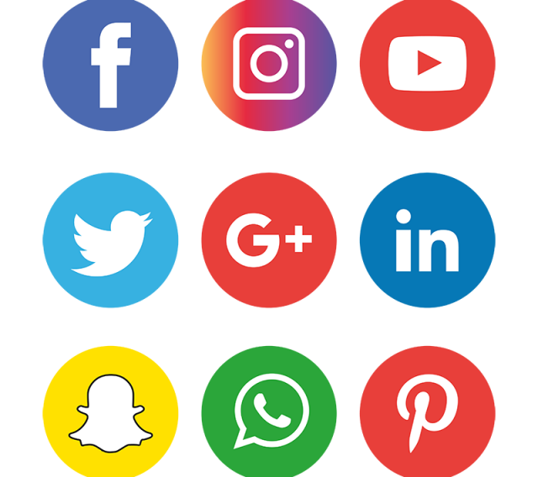
Top 5 Accessibility Tips
Keep words simple and clear, use plain English
Use Camel Case when writing hashtags
Use alt text (alternative text) to describe images, or, add descriptions of content within main body of tweets or posts
Add captions to your videos. Share videos via Youtube.
Use contrasting colours for infographics or posters
Bonus: [Web] Describe hyperlinks, refrain from using ‘click this link’, ‘click here’, etc.

Slide 4

Facebook
Alt text: instructions
Add captions to the photos you post. This helps to describe image contents to individuals using screen readers
Leave mentions, tags and hashtags until the end of your post
Follow Facebook Accessibility page @accessibility
Facebook Accessibility Documentation/Support: https://www.facebook.com/help/accessibility

Slide 5
Twitter
Alt text: instructions
Make hashtags accessible using ‘Camel Case’. #ThisIsAccessible whereas #thisisnotaccessible
When you tweet a hyperlink, indicate whether it leads to [AUDIO], [PIC] or [VIDEO]
Use a URL shortner to minimize the number of characters in the hyperlink (e.g. Bitly.com, Tiny.cc)
Twitter Accessibility Documentation/Support: https://help.twitter.com/en/using-twitter/picture-descriptions

Slide 6

Instagram
Instagram is one of the least accessible social media platforms
Alt text: instructions
Use the post’s description area to add alternative text to caption video posts
Use the text feature to add captions to your Instagram Stories
Embed open captions to videos before uploading to Instagram (e.g. Kapwing.com)
Instagram Accessibility Documentation/Support: https://help.instagram.com/503708446705527

Slide 7
Youtube
Provide links to accessible versions of video content on Youtube. Take advantage of Youtube’s automatically generated closed captions
Closed captions can be turned on and off whereas open captions are embedded into video
These captions can be edited through Youtube’s caption editor and a time-stamped transcript can be downloaded
Youtube Accessibility Documentation/Support: https://support.google.com/youtube/answer/189278?hl=en

Slide 8

Zoom – Accessibility Features
Closed Captioning: Available from 3rd party captioning providers. Ability to assign captioning duty to a participant.
Keyboard Accessibility: Keyboard shortcuts available for navigation throughout platform.
[Paid feature] Automatic Transcripts: Automatically generated, timestamped, downloadable and searchable transcripts available for recordings stored in the Zoom cloud.
Screen Reader Support.
Pin Video/Specific Speaker: Useful if interpreters are attending a meeting.
Zoom Accessibility Documentation/Support: https://zoom.us/accessibility

Slide 9

MS Teams – Accessibility Features
Closed Captions: Live auto-generated closed captions.
Keyboard Accessibility: Keyboard shortcuts available for navigation throughout platform.
Pin Participants/Specific Speakers: Useful if interpreters are attending a meeting.
Immersive Reader: for Chat function etc.
Zoom feature available across the entire platform.
High Contrast Theme
MS Teams Accessibility Documentation/Support: https://support.office.com/en-us/article/accessibility-overview-of-microsoft-teams-2d4009e7-1300-4766-87e8-7a217496c3d5

Slide 10
3 Things You Can Do Today
Read our Accessibility Information here: https://www.tcd.ie/disability/teaching-info/TIC/materials/social-media.php
Use Alt text to describe the images you post
Start using ‘Camel Case’ for #Hashtags
Contact us at askds@tcd.ie or orourkk3@tcd.ie for information/advice

Slide 11
Thank You

