Slide 1
REAMs is a web-based platform. In your preferred browser type in the address:
ethics.tcd.ie

Slide 2
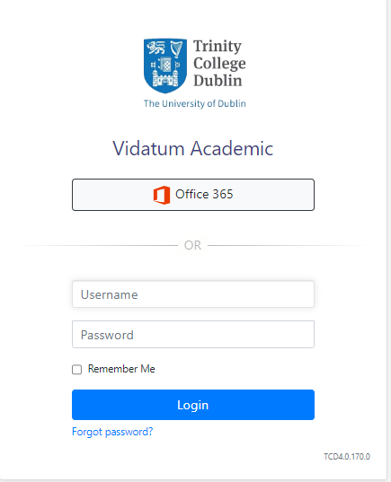
TCD staff and students sign in through Office 365
Click the Office 365 button on the login page
Enter your TCD Email
Enter your TCD password
TCD users:
TCD Email +
TCD password

